Slide 1
P, NP, NP Hard, NP Complete
Focus of this lecture = get the definitions across

Slide 2
Complexity definitions (seen in 592)
Big-Oh
Big-Theta
Big - Omega

Slide 3
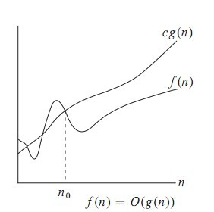
Big Oh (O)
f(n)= O(g(n)) iff there exist positive constants c and n0 such that f(n) ≤ cg(n) for all n ≥ n0
O-notation to give an upper bound on a function

Slide 4
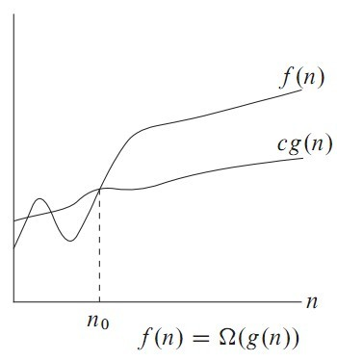
Omega Notation
Big oh provides an asymptotic upper bound on a function.
Omega provides an asymptotic lower bound on a function.

Slide 5

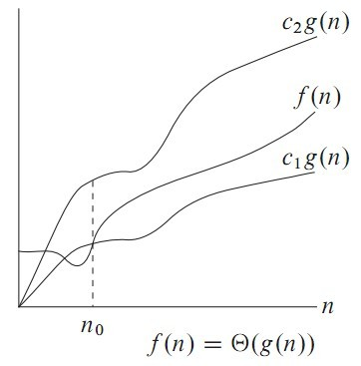
Theta Notation
Theta notation is used when function f can be bounded both from above and below by the same function g

Slide 6
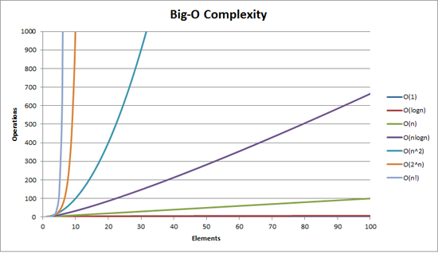
How bad is exponential complexity
Fibonacci example – the recursive fib cannot even compute fib(50)

Slide 7
The class P
The class P consists of those problems that are solvable in polynomial time.(+, -, *, …..)
More specifically, they are problems that can be solved in time O(n^{k}) for some constant k, where n is the size of the input to the problem
The key is that n is the size of input

Slide 8


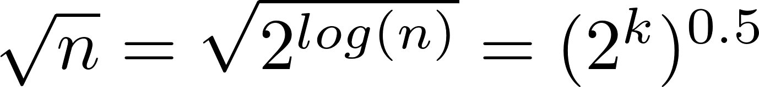
What is the complexity of primality testing?
public static boolean is Prime(int n){
boolean answer = (n>1)? true: false;
for(int i = 2; i*i <= n; ++i)
{
System.out.printf("%d\n", i);
if(n%i == 0)
{
answer = false;
break;
}
}
return answer;
}
This loops until the square root of n
So this should be
But what is the input size?
How many bits does it take to represent the number n?
log(n) = k
What is
Naïve primality testing is exponential!!

Slide 9
Why obsess about primes?
Crypto uses it heavily
Primality testing actually is in P
Proven in 2002
Uses complicated number theory
AKs primality test

Slide 10
NP
NP is not the same as non-polynomial complexity/running time. NP does not stand for not polynomial.
NP = Non-Deterministic polynomial time
NP means verifiable in polynomial time
Verifiable?
If we are somehow given a ‘certificate’ of a solution we can verify the legitimacy in polynomial time

Slide 11
What happened to automata?
Problem is in NP if it is decidable by some non deterministic Turing machine in polynomial time.
Remember that the all the model we have seen so far is a deterministic Turing machine
It is provable that a Non Deterministic Turing Machine is equivalent to a Deterministic Turing Machine
Remember NFA to DFA conversion?
Given an NFA with n states how many states does the equivalent DFA have?
Worst case …. 2^{n}
The deterministic version of a poly time non deterministic Turing machine will run in exponential time (worst case)

Slide 12
NP problems
Graph theory has these fascinating(annoying?) pairs of problems
Shortest path algorithms?
Longest path is NP complete (we’ll define NP complete later)
Eulerian tours (visit every vertex but cover every edge only once, even degree etc). Solvable in polynomial time!
Hamiltonian tours (visit every vertex, no vertices can be repeated). NP complete

Slide 13
Hamiltonian cycles
Determining whether a directed graph has a Hamiltonian cycle does not have a polynomial time algorithm (yet!)
However if someone was to give you a sequence of vertices, determining whether or not that sequence forms a Hamiltonian cycle can be done in polynomial time
Therefore Hamiltonian cycles are in NP

Slide 14
SAT
A boolean formula is satisfiable if there exists
some assignment of the values 0 and 1 to its variables that causes it to evaluate
to 1.
CNF – Conjunctive Normal Form. ANDing of clauses of ORs

Slide 15
2-CNF SAT
Each or operation has two arguments that are either variables or negation of variables
The problem in 2 CNF SAT is to find true/false(0 or 1) assignments to the variables in order to make the entire formula true.
Any of the OR clauses can be converted to implication clauses
(¬x∨y)∧(¬y∨z)∧(x∨¬z)∧(z∨y)

Slide 16
2-SAT is in P
Create the implication graph
¬x
y
x
¬y
¬z
z

Slide 17


Satisfiability via path finding
If there is a path from
And if there is a path from
Then FAIL!
How to find paths in graphs?
DFS/BFS and modifications thereof

Slide 18
3 CNF SAT (3 SAT)
Not so easy anymore.
Implication graph cannot be constructed
No known polytime algorithm
Is it NP?
If someone gives you a solution how long does it take to verify it?
Make one pass through the formula and check
This is an NP problem

Slide 19
P is a subset of NP
Since it takes polynomial time to run the program, just run the program and get a solution
But is NP a subset of P?
No one knows if P = NP or not
Solve for a million dollars!
http://www.claymath.org/millennium-problems
The Poincare conjecture is solved today

Slide 20
What is not in NP?
Undecidable problems
Given a polynomial with integer coefficients, does it have integer roots
Hilbert’s nth problem
Impossible to check for all the integers
Even a non-deterministic TM has to have a finite number of states!
More on decidability later
Tautology
A boolean formula that is true for all possible assignments
Here just one ‘verifier’ will not work. You have to try all possible values

Slide 21
Amusing analogy (thanks to lecture notes at University of Utah)
Students believe that every problem assigned to them is NP-complete in diﬃculty level, as they have to ﬁnd the solutions.
Teaching Assistants, on the other hand, ﬁnd that their job is only as hard as NP, as they only have to verify the student’s answers.
When some students confound the TAs, even veriﬁcation becomes hard

Slide 22
Reducibility
a problem Q can be reduced to another problem Q’ if any instance of Q can be “easily rephrased” as an instance of Q’, the solution to which provides a solution to the instance of Q
Is a linear equation reducible to a quadratic equation?
Sure! Let coefficient of the square term be 0

Slide 23
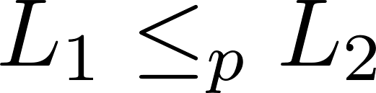
NP - hard
What are the hardest problems in NP?
That notation means that L₁ is reducible in polynomial time to L₂ .
The less than symbol basically means that the time taken to solve L₁ is no worse that a polynomial factor away from the time taken to solve L₂.

Slide 24
NP-hard
A problem (a language) is said to NP-hard if every problem in NP can be poly time reduced
to it.

Slide 25
NP Complete problems/languages
Need to be in NP
Need to be in NP-Hard
If both are satisfied then it is an NP complete problem
Reducibility is a transitive relation.
If we know a single problem in NP-Complete that helps when we are asked to prove some other problem is NP-Complete
Assume problem P is NP Complete
All NP problems are reducible to this problem
Now given a different problem P’
If we show P reducible to P’
Then by transitivity all NP problems are reducible to P’

Slide 26
What is in NP-Complete
For this course, we will axiomatically state that the following problems are NP-Complete
SAT – Given any boolean formula, is there some assignment of values to the variables so that the formula has a true value
3-CNF SAT
Actually any boolean formula can be reduced to 3-CNF form

Slide 27
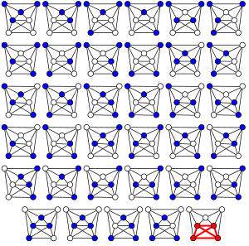
An example reduction
CLIQUE problem
A clique in an undirected graph is a subset of vertices such that each pair is connected by an edge.
We want to take a problem instance in 3-CNF SAT and convert it to CLIQUE finding
The brute force algorithm finds a 4-clique in this 7-vertex graph (the complement of the 7-vertex path graph) by systematically checking all C(7,4) = 35 4-vertex subgraphs for completeness.

Slide 28
Reducing 3CNF SAT to CLIQUE
Given – A boolean formula in 3 CNF SAT
Goal – Produce a graph (in polynomial time) such that
We will construct a graph where satisfying formula with k clauses is equivalent to finding a k vertex clique.

Slide 29
CLIQUE
An instance of a clique problem gives you 2 things as input
Graph
Some positive integer k
Question being asked = do we have a clique of size k in this graph
Why can’t I just go through and pick all possible k-subsets?

Slide 30
Decision problems versus optimization problems
Finding the maximum sized clique is an optimization problem
But we can reduce it to a series of decision problems
Can we find a clique of size 3 (why start at 3??)
Can we find a clique of size 4
Etc
In general in our study of NP etc, we will focus on decision problems

Slide 31
REDUCE 3-CNF SAT to CLIQUE
For each clause, create a vertex for each literal
For the edges
Connect vertices if they come from different clauses
Even if the vertices come from different clauses, do not connect if it results in incompatibility. No variable should be connected to its not.
x₁
x₁
x₁
There are more edges in here. Refer to the CLRS book to get the complete picture
┐
┐x₂
x₂
x₂
┐x₃
x₃
x₃

Slide 32
Vertex cover problem
A vertex cover of an undirected graph G=(V,E) is a subset of vertices such that every edge is incident to at least one of the vertices
We’re typically interested in finding the minimum sized vertex cover
To show vertex cover is NP-complete
What problem should we try to reduce to it
It sounds like the ‘reverse’ of CLIQUE
Reduction is done from CLIQUE to vertex cover

Slide 33
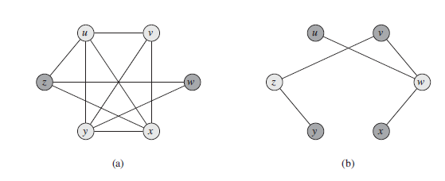

G’ = Complement
Of
G
G
Clique of size k in G exists iff a vertex cover of size |V| - k exists in G’ where G’ is the complement graph (vertices that had an edge between then in G do not have one in G’ and vice versa)

Slide 34
The original graph has a u,v,x,y CLIQUE. That is a clique of size 4
The complement graph has a vertex cover of size 6 (number of vertices) – 4 (clique size). z,w is one such vertex cover.

Slide 35
The reducibility ‘tree’
Richard Karp proved 21 problems to be NP complete in a seminal 1971 paper
Not that hard to read actually!
Definitely not hard to read it to the point of knowing what these problems are.
karp's paper

Slide 36
Amusing/tragic NP story
Breaking up over NP

Slide 37
Other NP complete problems
Subset sum
Given a set of positive integers and some target t > 0,
do we have a subset that sums up to that target set
Why is the naïve algorithm going to be bad?

Slide 38
Approximation algorithm for Vertex cover
C←∅
while E = ∅
pick any {u, v} ∈ E
C ← C ∪ {u, v}
delete all edges incident to either u or v
return C

Slide 39
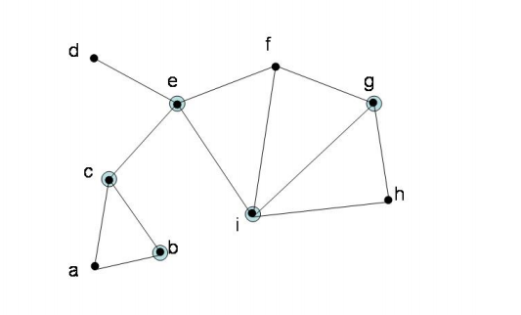
How bad is that approximation?
Look at the edges returned in that algorithm
Will the optimum vertex cover include at least one end point of the edges returned from approx algorithm?

